Slide 1

Powering Personalized Recommendation
Precision Marketing in E-Commerce
Analyze browsing/purchase data
2. Dynamic user segmentation
3. Case: 78.8% conversion boost(Luo, 2024)

Slide 2
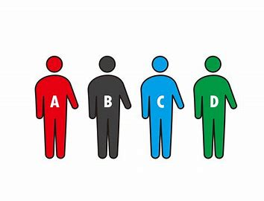
Powering Personalized Recommendation
Customized Solutions Across Industries
Education: Adaptive learning
(Thimmanna et al., 2024)
2. Healthcare: Gene-based care
(Estape et al., 2016)

Slide 3
Tech Barrier
Algorithmic Complexity
IMPA algorithm complexity
High-dimension IoT delays
Time-sensitive decision risks
(Alrayes et al., 2025)

Slide 4

Tech Barrier
Prohibitive Deployment Costs
PPSLOA-HDBDE demands GPUs
Edge deployment ×3-5 cost
Energy consumption alerts(Alrayes et al., 2025)

Slide 5
Efficiency-Aware Breakthroughs
MobileNetV3: 60% cost cut
Federated edge training
Cloud dependency ↓80%(Alrayes et al., 2025)

